Slide 1
INTRODUCTION TO MEDICAL SURGICAL NURSING

Slide 2
MAIN OBJECTIVE:
To acquire knowledge on medical-surgical nursing and develop skills and attitudes in the management of patients with medical and surgical conditions.
SUB-OBJECTIVES
The student will be able to:
Discuss historical development of Medicine and Surgery.
Classify the disease/condition according to their etiology.
Describe the disease process (Pathophysiology)
Describe common medical-surgical conditions

Slide 3
Assignment
1. Write notes on historical development of Medicine and Surgery

Slide 4
Background
Medical /surgical nursing- broad nursing specialty that provide care for adult patients with either /both acute and chronic conditions.
This requires broad knowledge on body system, surgical and medical pathologies, clinical skills, clinical decision making as well as collaborative skills.
According to Florence Nightingale, the goal of nursing was to put the patient in the best condition for nature to act upon him.
.

Slide 5
Cont’----
Roles of the Nurse in medical surgical nursing
Nurse practitioner- makes interventions, teaches patient,families and communities and also collaborates care
Leadership role- this role demands ,decision making, facilitation,influencing and relating with other nurses in order to meet patients, families and community health needs.
Reseacher role- every nurse should participate in research in order to answer the questions and improve on the practice and hence the need to understand research methods
Expanded nursing roles- an increase in health care demands leads to the need for ability to independent decision making hence the need for specialization e.g critical care nursing, family health nursing, orthopedic nursing among many others.

Slide 6
Models of Nursing Care Delivery
Task based/functional nursing
Primary nursing
Team nursing
Case based management
Community-based / community health

Slide 7
Health care delivery system
Changes in delivery of health care have been propelled by:
Demographic changes- increase in population due to improved health care, expanded lifespan, flexible global movement,urbanization etc
Emerging and reemerging diseases
Aging population- health promotion, disease prevention and rehabilitative services led to prolongation of life as well as reduction in acute ilnesses but an increase in chronic illneses
Technological advances- diagnostic and therapeutic equipments.
Economical changes- high costs of health care

Slide 8
Concepts and Definition of terms
Medicine - The branch of medical science that deals with nonsurgical techniques of treating illnesses
Surgery - The branch of medical science that treats disease or injury by operative procedures
Health- state of complete physical, mental, and social well-being and not merely the absence of disease.
Sepsis - presence of pathogens or their toxins
Surgical asepsis - Condition of being aseptic (sterile) aseptic treatment and technique
Aseptic technique - All steps taken to prevent contamination of surgical site by infectious agents

Slide 9
Sterile - complete absence of microbes via the cleansing process
Curettage - surgery to remove tissue or growths from a bodily cavity (as the uterus) by scraping with a curette
Debridement - surgical removal of foreign material and dead tissue from a wound in order to prevent infection and promote healing
Dehiscence - Bursting open of a wound, especially a surgical abdominal wound

Slide 10
Health–Illness continuum - considers a person as having neither complete health nor complete illness. Instead, a person’s state of health is ever-changing and has the potential to range from high-level wellness to extremely poor health status.
The patient/client: the one with health care needs. Care should be focused on the patient /client. Identification of the immediate health care need is a fundamental nursing requirement

Slide 11
PROCESS OF INFLAMMATION

Slide 12

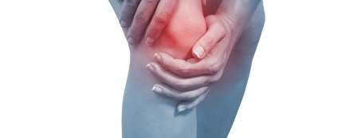
Introduction
INFLAMMATION:
Definition 1: the local response of living body tissues to injury due to any agent.
Definition 2: The complex biological response of body tissues to harmful stimuli, such as pathogens, damaged cells, or irritants

Slide 13
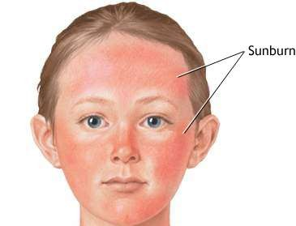
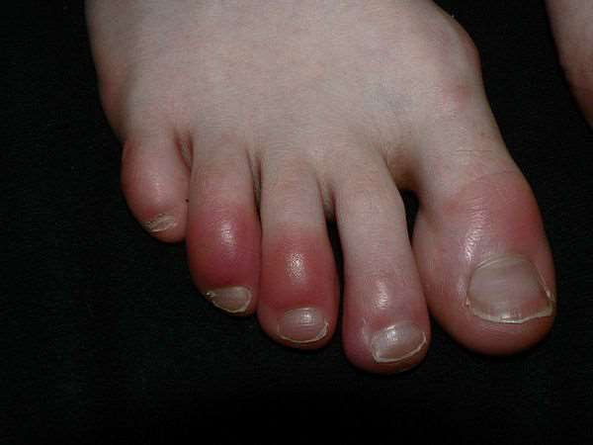
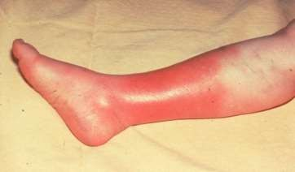

Slide 14
Cont..
Inflammation is a protective response involving;
immune cells,
blood vessels,
molecular mediators
It is also the body defense reaction – to eliminate or limit the spread of injurious agent

Slide 15
Causes of Inflammation
Infective agents like bacteria, viruses, fungi, parasites (and their toxins).
Immunological agents like cell-mediated and antigen antibody reactions.
Physical agents like heat, cold, radiation, mechanical trauma.
Chemical agents like organic and inorganic poisons.
Inert materials such as foreign bodies (chemically inactive)

Slide 16
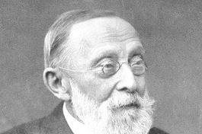
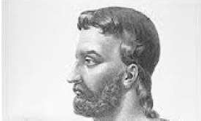
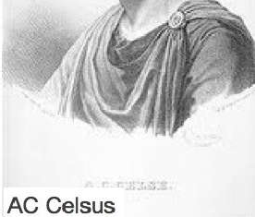
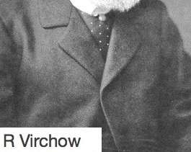
Signs of inflammation
4 cardinal signs (according to Celsus)
Redness
Swelling
Heat
Pain
5th sign
- Loss of function – (according to Virchow)

Slide 17
Types of inflammation
Mainly of 2 types i.e. acute and chronic
Acute Inflammation
short duration
represents the early body reaction- followed by healing
Chronic inflammation
longer duration
causative agent of acute inflammation persists for a long time

Slide 18
INFLAMMATORY RESPONSE/PROCESS/THE PROCESS OF INFLAMMATION
Involves the following events:
VASCULAR EVENTS/RESPONSE
Hemodynamic changes
Altered vascular permeability
CELLULAR EVENTS/RESPONSE
Exudation of leukocytes
Phagocytosis

Slide 19
VASCULAR EVENTS/RESPONSE
a) Hemodynamic changes
Transient vasoconstriction: Is the immediate vascular response to achieve hemostasis irrespective of type of injury .
Persistent progressive vasodilation: Involves mainly arterioles but to a lesser extent, capillaries. It results in increased blood volume in the micro-vascular bed of the site of acute inflammation.
Elevated local hydrostatic pressure: Caused by progressive vasodilation which results in transudation of fluid into the local site causing edema.

Slide 20
Slowing/stasis of microcirculation follows, causing increased concentration of RBCs and thus raised blood viscosity.

Slide 21
Altered vascular –permeability
There are two mechanisms –:
Chemical mediators of acute inflammation may cause retraction of endothelial cells, leaving intercellular gaps (chemical mediated vascular leakage).
Toxins and physical agents may cause necrosis of vascular endothelium, leading to abnormal leakage (injury induced vascular leakage).

Slide 22
CELLULAR EVENTS/RESPONSE
Includes:
i) Formation of the Cellular Exudate
How do white blood cells get out of the circulation and into the area where they are needed?
The movement of leukocytes from the vessel lumen in a directional fashion to the site of tissue damage is called chemotaxis.
All granulocytes and monocytes respond to chemotactic factors and move along a concentration gradient (from an area of lesser concentration of the factor to an area of greater concentration of the factor).

Slide 23
ii) Phagocytosis
The process whereby cells ingest solid particles is termed phagocytosis.
The first step in phagocytosis is adhesion of the particle to be phagocytosed to the cell surface. The phagocyte ingests the attached particle by sending out pseudopodia around it. These meet and fuse so that the particle lies in a phagocytic vacuole (also called a phagosome) bounded by cell membrane. Lysosomes, then fuse with phagosomes to form phagolysosomes. It is within these that intracellular killing of microorganisms occurs.

Slide 24
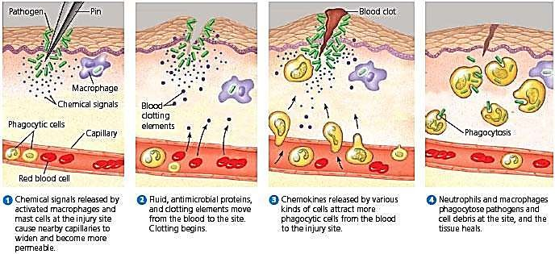
INFLAMMATION PROCESS;

Slide 25
Factors that can influence chronic inflammation;
Dietary factors,
Physical activity,
Smoking
Obesity
Alcohol consumption
Stress can affect inflammation.

Slide 26
DISORDERS OF INFLAMMATION
Inflammatory abnormalities are a large group of disorders that underlie a vast variety of human diseases.
Examples of disorders associated with inflammation include:
Acne vulgaris
Asthma
Autoimmune diseases
Chronic prostatitis
Diverticulitis
Glomerulonephritis
Hypersensitivities

Slide 27
MANAGEMENT OF PATIENTS WITH INFLAMMATION
FEVER/PYREXIA: Occurs due to bacteremia. Administer prescribed antipyretics e.g paracetamol. Give high calorie diet in the form of carbohydrates. This is to meet the increased metabolic demand in patients with fever.
LEUCOCYTOSIS: Usually in bacterial infections there is neutrophilia, viral infections cause lymphocytosis, parasitic infections cause eosinophilia. Administer prescribed antibacterial agents.
DIET: Provide easily digestible diet (light diet), keep the fluid balance, and give high protein diet for the formation of new tissue to build up the destroyed tissue.

Slide 28
SEDATION: Inflammation will produce pain, therefore sedative drugs may be given to induce sleep.
SHOCK: Systematic activation of coagulation pathway may occur leading to microthrombi throughout the body and results into DIC, bleeding and death. Severe tissue injury results in profuse systemic vasodilation, increased vascular permeability and intravascular volume loss causing hypotension and shock. Give plenty of I.V fluids.
PAIN: Immobilize the affected limb, administer prescribed analgesics. Give anti-inflammatory agents e.g ibuprofen, indomethacin, steroids e.g prednisone and dexamethasone.

Slide 29
REST: Elevate the affected limb. The inflamed part is rested by elevation. In case of arms use splints, and for lower limbs use pillows and clear.
LOCAL TREATMENT: If the inflammation is broken and septic, use antiseptics to kill the pathogenic microbes in in the wound. Examples of antiseptics include: hydrogen peroxide, hibitane (Chlorexidine).

Slide 30
Systemic effects of inflammation
Fever : infectious form of inflammation
Anaemia
Leucocytosis
Septic shock

Slide 31
CLASSIFICATION OF
DISEASES

Slide 32
INTRODUCTION
A disease is a particular abnormal condition that affects part or all of an organism and is not caused by external force (injury).
Disease is often interpreted as a medical condition associated with specific symptoms and signs.
It may be caused by external factors such as pathogens or by internal dysfunctions, particularly of the immune system, such as an immunodeficiency, or by a hypersensitivity,
including allergies and autoimmunity.

Slide 33
Diseases may be classified by cause, pathogenesis or by symptom(s).
Alternatively, diseases may be classified according to the organ system involved, though this is often complicated since many diseases affect more than one organ.
The most known and used classification of diseases is the World Health Organization's ICD (International Statistical Classification of Diseases and Related Health Problems). This is periodically updated.

Slide 34
ICD
The International Classification of Diseases (ICD) is the international "standard diagnostic tool
for epidemiology, health management and clinical purposes".
Its full official name is International Statistical Classification of Diseases and Related Health Problems.
The ICD is designed as a health care classification system, providing a system of diagnostic codes for classifying diseases.
It contains codes for diseases, signs and symptoms, abnormal findings, complaints, social
circumstances, and external causes of injury or diseases.
The first international classification edition, known as the International List of Causes of Death, was adopted by the International Statistical Institute in 1893.

Slide 35
Disease classification :
There are four main classes of disease
Genetic disease
Infectious disease (infections)
Neoplasmic (benign or malignant) disease
Traumatic disease (injuries)
Diseases can also be classified as communicable and non-communicable.

Slide 36
i. Genetic disease
A genetic disease is a genetic problem caused by one or more abnormalities formed in the genome.
Most genetic disorders are quite rare
Genetic disorders may be hereditary or non-hereditary, meaning that they are passed down from the parents' genes.
However, in some genetic disorders, defects may be caused by new mutations, altered phenotype, or changes to the DNA.
Examples: albinism, sickle-cell disease, hemophilia etc

Slide 37
ii. Infectious disease (infections)
Infectious diseases are disorders caused by organisms — such as bacteria, viruses, fungi or parasites.
Some infectious diseases can be passed from person to person.
Some are transmitted by insects or other animals. And one may get others by consuming contaminated food or water or being exposed to organisms in the environment.
Signs and symptoms vary depending on the organism causing the infection, but often include fever and fatigue.

Slide 38
Mild infections may respond to rest and home remedies, while some life-threatening infections may need hospitalization.
Many infectious diseases, such as measles and chickenpox, can be prevented by vaccines.
Frequent and thorough hand-washing helps to protect individuals from most infectious diseases.

Slide 39
iii. Neoplasmic (benign or malignant) disease
A neoplasm is a type of abnormal and excessive growth, called neoplasia, of tissue.
The growth of a neoplasm is uncoordinated with that of the normal surrounding tissue, and it persists growing abnormally, even if the original trigger is removed.
This abnormal growth usually (but not always) forms a mass. When it forms a mass, it may be called a tumor.
ICD-10 classifies neoplasms into the following main groups: benign neoplasms, malignant neoplasms, and neoplasms of uncertain or unknown behavior. Malignant neoplasms are also simply known as cancers and are the focus of oncology.

Slide 40
Types of neoplasms
A neoplasm can be benign or malignant (cancer).
Benign tumors include uterine fibroids.
They are circumscribed, localized and do not transform into cancer.
Malignant neoplasms are commonly called cancer.
They invade and destroy the surrounding tissue, may form metastases and, if untreated or unresponsive to treatment, will generally prove fatal.
Secondary neoplasm refers to any of a class of cancerous tumor that is a metastatic offshoot of a primary tumor.
If a metastatic neoplasm has no known site of the primary cancer, it is classified as a cancer of unknown primary origin

Slide 41
iv. Traumatic disease (injuries)
Trauma most often refers to:
Psychological trauma, a type of damage to the psyche that occurs as a result of a severely distressing event
Traumatic injury, sudden physical injury caused by an external force, which does not rise to the level of major trauma

Slide 42
Disease Classification:
The other widely used classifications of disease are :
(1) Topographic, by bodily region or system,
(2) Anatomic, by organ or tissue,
(3) Physiological, by function or effect,
(4) Pathological, by the nature of the disease process,
(5) Etiologic (causal)
(6) Epidemiological

Slide 43
1. Topographic classification
In the topographic classification, diseases are subdivided into such categories as gastrointestinal disease, vascular disease, abdominal disease, and chest disease.
Various specializations within medicine follow such topographic or systemic divisions, so that there are physicians who are essentially vascular surgeons, for example, or clinicians who are specialized in gastrointestinal disease.
Similarly, some physicians have become specialized in chest disease and concentrate principally on diseases of the heart and lungs.

Slide 44
2. Anatomic classification
In the anatomic classification, disease is categorized by the specific organ or tissue affected; hence, heart disease, liver disease, and lung disease.
Medical specialties such as cardiology are restricted to diseases of a single organ, in this case the heart.
Such a classification has its greatest use in identifying the various kinds of disease that affect a particular organ.
The heart is a good example to consider.

Slide 45
3. Physiological classification
The physiological classification of disease is based on the underlying functional derangement produced by a specific disorder.
Included in this classification are such subclasses as respiratory and metabolic disease. Respiratory diseases are those that interfere with the intake and expulsion of air and the exchange of oxygen for carbon dioxide in the lungs.
Metabolic diseases are those in which disturbances of the body’s chemical processes are a basic feature. Diabetes and gout are examples.

Slide 46
4. Pathological classification
The pathological classification of disease considers the nature of the disease process.
Neoplastic and inflammatory disease are examples.
Neoplastic disease includes the whole range of tumors, particularly cancers, and their effect on human beings.
Examples of Inflammatory diseases include: appendicitis, cellulitis, otitis media etc

Slide 47
5. Etiologic classification
The etiologic classification of disease is based on the cause, when known.
This classification is particularly important and useful in the consideration of biotic disease.
On this basis disease might be classified as bacterial (e.g. staphylococcal) or fungal, etc.
Bacteria for example, cause skin infections, pneumonia, meningitis, abscesses in the liver, and kidney infections.
Diseases such as amoebiasis (parasitic), chicken pox (viral), tinea capitis (fungal) and gonorrhea (bacterial) are further examples of diseases classified by etiology.

Slide 48
6. Epidemiological classification
The epidemiological classification of disease deals with the incidence, distribution, and control of disorders in a population.
To use the example of typhoid, a disease spread through contaminated food and water, it first becomes important to establish that the disease observed is truly caused by Salmonella typhi, the typhoid organism.
Once the diagnosis is established, it is important to know the number of cases, whether the cases were scattered over the course of a year or occurred within a short period, and what the geographic distribution is.

Slide 49
COMMON MEDICAL SURGICAL CONDITIONS

Slide 50
ABSCESS

Slide 51
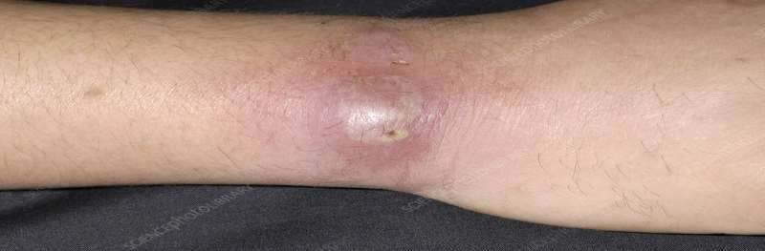
Abscess
Definition 1: An abscess is a cavity filled with pus . It contains white blood cells, dead tissue and bacteria.
Definition 2: localized collection of pus surrounded by inflamed tissue

Slide 52
TYPES OF ABSCESS
Abscesses can develop anywhere in the body.
Skin abscesses – which develop under the skin
Internal abscesses – which develop inside the body, in an organ or in the spaces between organs
Incisional abscess - An incisional abscess is one that develops as a complication secondary to a surgical incision.
It presents as redness and warmth at the margins of the incision with purulent drainage from it.
If the diagnosis is uncertain, an abscess should be aspirated with a needle, and the aspirated pus be presented for culture and sensitivity

Slide 53
Other abscesses
There are many other types of abscess, including:
Anorectal abscess – a build-up of pus in the rectum and anus
Bartholin's abscess – a build-up of pus inside one of the Bartholin's glands, which are found on each side of the opening of the vaginal orifice.
brain abscess – a rare but potentially life-threatening build-up of pus
inside the skull (cranium)
Dental abscess – a build-up of pus under a tooth or in the supporting gum and bone
Quinsy (peritonsillar abscess) – a build-up of pus between one of the tonsils and the wall of the throat (as complication of tonsilitis)
spinal cord abscess – a build-up of pus around the spinal cord

Slide 54
Causes of abscesses
Most abscesses are caused by a bacterial infection, parasites, or foreign substances, but bacteria is most common cause.
When bacteria enter the body, the immune system sends infection-fighting white blood cells to the affected area.
As the white blood cells attack the bacteria, some nearby tissues die, creating a space which then fills with pus to form an abscess. The pus contains a mixture of dead tissue, white blood cells and bacteria.

Slide 55
Internal abscesses often develop as a complication of an existing condition, such as an infection elsewhere in your body. For example, if the appendix bursts as a result of appendicitis, bacteria can spread inside the abdomen and cause an abscess to form.
The most common bacterial organism responsible for the development of skin abscesses is Staphylococcus aureus
With the emergence of methicillin-resistant Staphylococcus aureus (MRSA), health care providers must now consider this organism as the possible cause when a skin abscess is encountered.

Slide 56
Pathophysiology:
Upon entry of the organisms or foreign materials, Staphylococcus aureus for example kills the local cells, resulting in the release of cytokines.
The cytokines trigger an inflammatory response, which draws large numbers of white blood cells to the area and increases the regional blood flow.
The final structure of the abscess is an abscess wall, or capsule, that is formed by the adjacent healthy cells in an attempt to keep the pus from infecting neighboring structures.
However, such encapsulation tends to prevent immune cells from attacking bacteria in the pus, or from reaching the causative organism or foreign object.

Slide 57
Signs and Symptoms of skin abscesses:
A skin abscess often appears as a swollen, pus-filled lump under the surface of the skin.
Body malaise
Other symptoms of an infection, such as a fever,
chills.
warmth
redness (in the affected area)
A boil is a common example of a skin abscess.

Slide 58
common signs and Symptoms of internal abscesses
The signs and symptoms of an internal abscess can also vary depending on exactly where in the body the abscess develops.
For example, a liver abscess may cause jaundice, whereas an abscess in or near the lungs may cause a cough or shortness of breath.

Slide 59
General signs and symptoms of an internal abscess can include:
Discomfort in the area of the abscess
Fever
Increased sweating
Vomiting
Chills
Pain or swelling in the abdomen
Loss of appetite
Weight loss
Extreme tiredness (fatigue)
Diarrhoea or constipation

Slide 60
Risk factors:
You’re at increased risk for this bacterial infection if you have:
Close contact with an individual who has a staph infection, (which is why these infections are more common in hospitals)
A chronic skin disease, like acne or eczema
Diabetes
A weakened immune system, which can be caused by infections such as HIV
Poor hygiene habits

Slide 61
Risk factors cont..
Infected hair follicles (folliculitis)
Infected hair follicles, or folliculitis, may cause abscesses to form in the follicle. Follicles can become infected if the hair within the follicle is trapped and unable to break through the skin, as can happen after shaving.
Trapped hair follicles are commonly known as ingrown hairs. Ingrown hairs can set the stage for an infection. Abscesses that are on or in a hair follicle will often contain this ingrown hair.
Folliculitis may also occur after spending time in an inadequately chlorinated pool or hot tub.

Slide 62
Investigations
When taking medical history, ask:
How long the abscess has been present
If they recall any injury to that area
What drugs one may be taking
If they have any allergies
If they had a fever
Physical exam. Examine the abscess and surrounding areas.
Take a culture or a small amount of fluid from the abscess to test for the presence of bacteria

Slide 63
Difference between cyst and abscess
CYST
ABSCESS
A cyst is a closed sac that develops abnormally in some body structure
Symptoms:
A cyst grows slowly and isn’t usually painful, unless it becomes enlarged.
When an already-formed cyst becomes infected, it becomes an abscess.
Not infected.
An abscess is a pus-filled infection in the body caused by, for example, bacteria or fungi.
Symptoms:
Pain, redness, and swelling and can cause symptoms elsewhere in the body.
An abscess doesn’t have to begin as a cyst. It can form on its own.
An abscess is infected

Slide 64
Skin abscesses
Some small skin abscesses may drain naturally & get better without the need for treatment.
For larger or persistent skin abscesses, a course of Antibiotics may be prescribed to help clear the infection and prevent it from spreading.
Internal abscesses
The pus usually needs to be drained from an internal abscess, either by using a needle inserted through the skin (percutaneous abscess drainage) or with surgery.
The method used will depend on the size of the abscess and where it is in the body.
Antibiotics will usually be given at the same time, to help kill the infection and prevent it from spreading. These may be given as orally or intravenously.

Slide 65
Treatment:
A small skin abscess may drain naturally, or simply shrink, dry up and disappear without any treatment.
Abscesses can be treated in a number of different ways, depending on the type of abscess and how large it is.
The main treatment options include:
antibiotics
a drainage procedure
warm compress
Surgery

Slide 66
Surgery (Incision and drainage)
If the skin abscess needs draining, the patient will have a minor surgical operation carried out under anesthesia– usually a local anesthetic
During the procedure, an incision is made in the abscess, to allow the pus to drain out. A sample of pus may also be taken for testing.
Once all of the pus has been removed, the resulting hole that is left by the abscess is cleaned using sterile saline (a salt solution).
The abscess will be left open but covered with a wound dressing, so if any more pus is produced it can drain away easily.
If the abscess is deep, an antiseptic dressing may be placed inside the wound to keep it open. The procedure may leave a small scar.

Slide 67
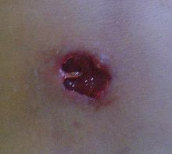
Abscess five days after incision and drainage

Slide 68
Percutaneous drainage
If the internal abscess is small, the surgeon may be able to drain it using a fine needle.
Depending on the location of the abscess, this may be carried out using either a local or general anaesthetic.
The surgeon may use ultrasound scans or computerised tomography (CT) scans to help guide the needle into the right place.
Once the abscess has been located, the pus is drained using the needle. A small incision may be made on the skin over the abscess, then insert a thin plastic tube called a drainage catheter into it.

Slide 69
The catheter allows the pus to drain out into a bag and may have to be left in place for up to a week.
This procedure may be carried out as a day case procedure, which means the patient may be able to go back home the same day, although some people will need to stay in hospital for a few days.
You may need to undergo surgery if:
Your internal abscess is too large to be drained with a needle
A needle can't get to the abscess safely
Needle drainage hasn't been effective in removing all of the pus
The type of surgery will depend on the type of internal abscess and where it is in the body.

Slide 70
Prevention of abscesses
Proper hygiene is the best way to avoid infection.
Keep cuts and wounds clean, dry, and covered to protect them from microorganisms.
Avoid sharing clothing, towels, razors, or bed linens with anyone else.
When these items get dirty, wash them separately in hot water.
Wash your hands well and often using soap and water for at least 20 seconds each time. It's OK to use alcohol-based instant hand sanitizers or wipes if you're not near any soap and water.

Slide 71
CARBUNCLES AND FURUNCLES

Slide 72
Carbuncles
Definition: A carbuncle is a cluster of boils that have multiple pus “heads.” They’re tender and painful, and cause a severe infection which could leave a scar.
Other names: Staph skin infection, Carbunculosis
A carbuncle is a staph skin infection.
Boils: A boil, also called a furuncle, begins as a painful infection of a single hair follicle.
So carbuncle is multiple furuncles.

Slide 73
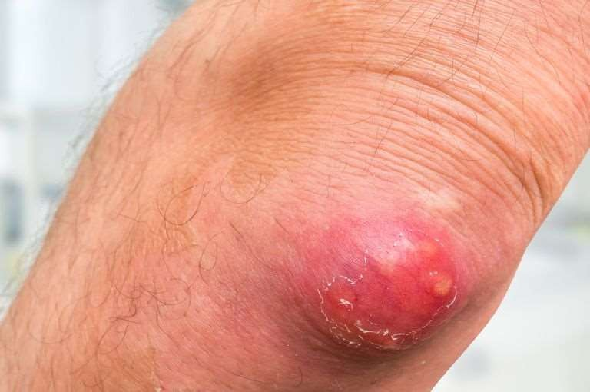
Carbuncles

Slide 74
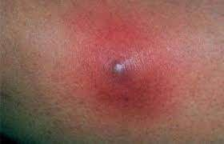
Furuncle/Boils
Definition: furuncle, begins as a painful infection of a single hair follicle.
Furuncles/Boils can grow to be
larger than a golf ball, and they commonly occur on the buttocks,
face, neck, armpits and groin.

Slide 75
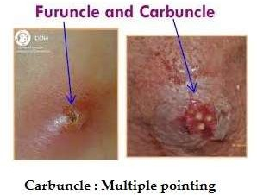

Slide 76
A hair follicle is a part of the skin, which grows a hair.
Attached inside the top of the follicle are sebaceous glands, which are tiny sebum-
producing glands in almost all skin except on the palms, lips and soles of the feet.
Causes:
A carbuncle usually develops when Staphylococcus aureus bacteria enter the hair follicles.
Entrance/Portal site:
insect bite and broken skin make it easy for bacteria to enter the body and cause an infection.
This can result in boils or carbuncles (a cluster of boils) filled with fluid and pus.

Slide 77
Location:
Carbuncles are common on the back of the neck, shoulders, or thigh. They can also appear on the face, armpits, or buttocks
Favourite environment of staph bacteria:
The moist parts of the body are particularly susceptible to this infection because bacteria thrive in these areas where you sweat or experience friction.

Slide 78
Risk factors:
Being in close contact with someone who has a carbuncle (the infection can spread when people share space, materials, or devices, such as clothing)
The following factors also increase the risk of developing a carbuncle:
Poor hygiene
Diabetes (High levels of blood sugar, or glucose, can reduce the immune system's ability to respond to infection.)
a weak immune system
Skin conditions: Psoriasis, eczema, and acne increase susceptibility.
kidney disease (renal carbuncle may have metastasis
Medications: Some medications weaken the immune system.
shaving and other activities that break the skin
Men get carbuncles more often than women. (scraps on face during shave)

Slide 79
Signs and Symptoms:
Boils can occur anywhere on your skin, but more likely on hair-bearing areas, where you're most likely to sweat or experience friction. Appear mainly on the face, back of the neck, armpits, thighs and buttocks.
Signs & symptoms include:
A painful, red bump that starts out small and can enlarge to more than 2 inches (5 centimeters)
Tenderness
Red, swollen skin around the bump
An increase in the size of the bump over a few days as it fills with pus
Development of a yellow-white tip that eventually ruptures and allows the pus to drain out.

Slide 80
A carbuncle usually:
Develops over several days
Have a white or yellow center (contains pus)
Weep, ooze, or crust
Spread to other skin areas
Sometimes, other symptoms may occur including:
Fatigue
Fever
General discomfort
Skin itching before the carbuncle develops

Slide 81
Exams and Tests
The diagnosis may base on clinical examination
A sample of the pus may be sent to a lab to determine the bacteria causing the infection (bacterial culture and sensitivity).
The test result helps determine the appropriate treatment.

Slide 82
Management :
Warm compresses -
Warn patient not to squeeze or incise the lesion
Systemic antibiotics (cloxacillin, erythromycin)
Bed Rest especially for genital area furuncles.
For severe pain: codeine, morphine
Antibiotics. Sometimes your doctor may prescribe antibiotics to help heal severe or recurrent infections.
For larger boils and carbuncles, treatment may include:
Incision and drainage. (when it is fluctuant). Deep infections that can't be completely drained may be packed with sterile gauze to help soak up and remove additional pus.

Slide 83
Lifestyle and home remedies
For small boils, these measures may help the infection heal more quickly and prevent it from spreading:
Warm compresses. Apply a warm washcloth or compress to the affected area several times a day, for about 10 minutes each time. This helps the boil rupture and drain more quickly.
Prevent contamination. Wash your hands thoroughly after treating a boil. Also, launder clothing, towels or compresses that have touched the infected area.

Slide 84
Complications
Rarely, bacteria from a boil or carbuncle can enter your bloodstream and travel to other parts of your body.
The spreading infection, commonly known as sepsis, can lead to infections deep within your body, such as your heart (endocarditis) and bone (osteomyelitis).
Preventions:
Wash your hands regularly with soap. Or use an alcohol-based hand
rub often. Careful hand-washing is your best defense against germs.
Keep wounds covered. Keep cuts and abrasions clean and covered with sterile, dry bandages until they heal.
Avoid sharing personal items. Don't share towels, sheets, razors, clothing, athletic equipment and other personal items

Slide 85
Comparison: carbuncle & furuncle.
Furuncle
Carbuncle
Begins as a painful infection of a single hair follicle.
Also known as boil
Not as deep as carbuncles.
Furuncles, affect a hair follicle and surrounding tissue.
This infection is not so deep.
Furuncles may go away without any intervention. May burst and heal without a scar within 2 days to 3 weeks.
It involves a group of infected hair follicles in one skin location.
Also known as cluster of boils.
Is a deeper skin infection
Carbuncles affect the deeper layers, and they can lead to scarring.
Carbuncle infections tend to be deeper and more severe
They take longer to develop and to resolve than furuncles. (often leave a scar)

Slide 86
CELLULITIS

Slide 87
CELLULITIS
Inflammation of subcutaneous tissues as a result of bacterial infection on any part of the body but mostly on lower limbs
Causative organisms
Streptococcus, staphylococus and H. influenzae after gaining entry through bites, breaks in the skin.

Slide 88
Risk factors:
Local trauma (e.g., lacerations, insect bites, wounds, shaving)
Skin infections such as impetigo, scabies, furuncle, tinea pedis
Underlying skin ulcer
Immunocompromised individuals
Diabetes mellitus

Slide 89
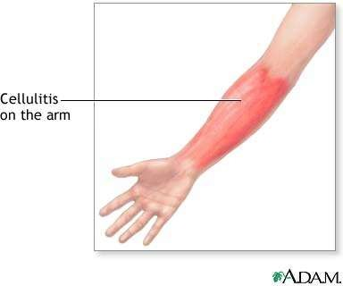
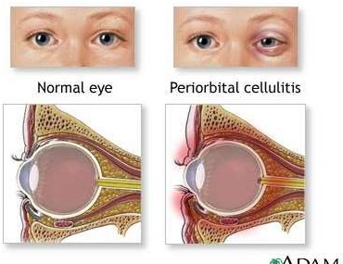
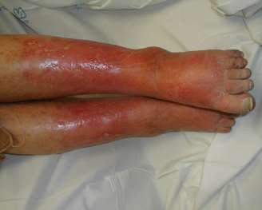
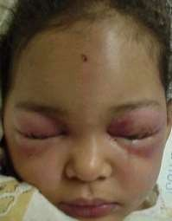

Slide 90
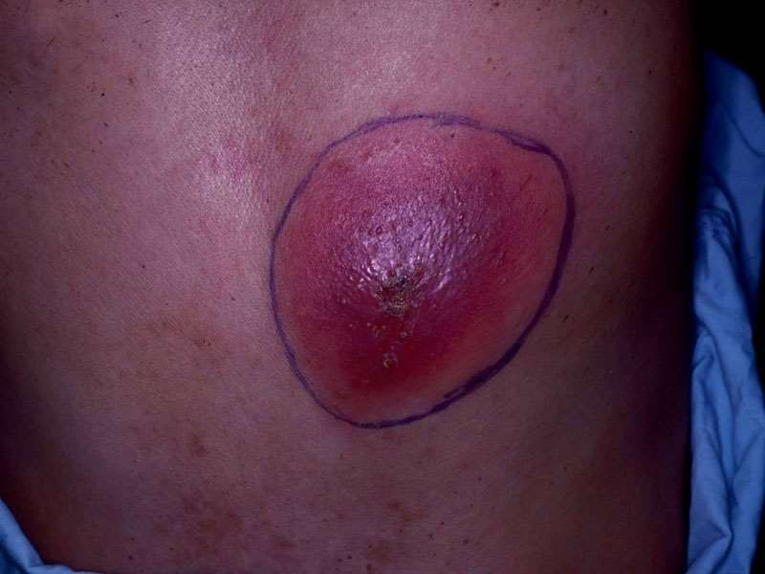

Slide 91
Pathophysiology
Break on the skin followed by acute inflammatory process that becomes chronic and may end up as an abcess
Signs and symptoms
The area is red ,hot and painful in the initial phase. It get swollen later which is related to inflammation processes

Slide 92
Medical management
Identify the port of entry
Antibiotics – penicillins if no MRSA (methicillin resistant staphylococcus aureus) but if any issue use cephalosporins, erythromycin, clindamycycin for at least 7 days to prevent recurrence.
If on limb elevate

Slide 93
When to give IV not PO?
Patients with mild infection ------> administer oral antibiotics.
Administer IV if:
Systemic signs of toxicity (eg, fever >38°C, hypotension, or sustained tachycardia)
Rapid progression of erythema
Progression of clinical findings after 48 hours of oral antibiotic therapy
Inability to tolerate oral therapy
Proximity of the lesion to an indwelling medical device (ex: prosthetic joint)

Slide 94
Medical treatment for non-purulent cellulitis
Orals medications:
Clindamycin
Amoxicillin PLUS septrin
Amoxicillin PLUS doxycycline
Amoxicillin PLUS minocycline
Intravenous meds
Vancomycin
Oxacillin

Slide 95
Medical treatment for purulent cellulitis and Skin Abscesses
Start IV Rx, Switch to PO once signs of infection resolved.
Orals medications:
Clindamycin, septrin, doxycycline, minocycline
Intravenous meds
Vancomycin PLUS one of the following:
Ampicillin
Ceftriaxone + metronidazole
Ciprofloxacin + metronidazole
Levofloxacin + metronidazole

Slide 96
PO options after s/s resolution:
clindamycin, SEPTRIN, or tetracyclines (doxycycline or minocycline)
Duration of treatment:
In general ----> 5 days
Up to 14 days if:
Severe infection
Slow response to therapy
Immunosuppression.

Slide 97
Non-pharmacologic Interventions
Apply warm or, if more comfortable, cool saline compresses to affected areas QID for 15 minutes.
Mark border of erythema with pen to monitor spread.
Elevate, rest and gently splint the affected limb.

Slide 98
Nursing management
Assess the patient
subjective data may include
Pain
Chills
Headache
Nausea
Objective data
Redness/tenderness Swelling
Warmth on the tisses affected

Slide 99
Nursing Diagnosis
Acute pain related to tissue inflammation as evidenced by patient’s
verbalization/ body expression/ tarchycardia
Interventions
Rate the pain by the scales
Administer analgesics as prescribed
Use other pain relieving measures such as elevation of limb/ rest the limb
Impaired tissue integrity (subcutenous )related to microbial invasion as evidenced by swelling, redness and tenderness

Slide 100
Interventions
Place warm moist cloths on the swollen area
Give antibiotics
Administer pain relieving drugs as prescribed
If on lower limb elevate the leg
Monitor the progress

Slide 101
Complications:
Bacteremia
Endocarditis
Osteomyelitis
Sepsis

Slide 102
LYMPHANGITIS

Slide 103
LYMPHANGITIS
Acute inflammation of the lymphatic channels.
Causative organisms- Hemolytic streptococus, staph aureus, pseudomonas, fungi
Signs and symptoms
Focal point –a skin lesion or wound
Tender red streaks radiating from the wound towards nearest lymph node
Fever, chills
General malaise
Swollen lymph nodes

Slide 104
Medical management
As outpatient or if severe as in patient
Antibiotics
Antinflammatory agents
Analgesics
Hot moist compressions on affected areas
Drainage of abscess if any
Nursing management
Manage Pain, Fever, General malaise

Slide 105
Lymphangitis can spread quickly, leading to complications such as:
Cellulitis
Bacteremia
Sepsis,
Abscess

Slide 106
SEPTICAEMIA

Slide 107
SEPTICAEMIA
Definition: Infection in the bloodstream also refered to as bacteremia
Causes
Results from other outbrown focal infections e.g. Lungs, urinary system or introduced through invasive procedures

Slide 108
CAUSATIVE ORGANISMS
Staphylococcus
Streptococcus
Pseudomonas
Escherichia coli (E.coli)
Pathophysiology
Entry of bacteria into the blood stream, Triggers an immune response, inflammatory process, leading to shut down of infection fighting system and shock then death

Slide 109
CLINICAL MANIFESTATIONS
Early symptoms include:
Fever/hyperthermia
Rapid breathing rate (tachypnea) or shortness of breath.
Rapid heart rate (tachycardia)
Low blood pressure
Anxiety
Reduced urine output/oliguria
Malaise
Loss of appetite, nausea and vomiting.

Slide 110
As the septicaemia progresses, the symptoms become more severe and includes:
Change in mental status,
Delusions
coma.
Red spots on the skin (petechiae) due to blood clotting problems.

Slide 111
DIAGNOSTIC TESTS
Blood culture to detect the causative organism
Blood gases analysis
Complete blood count (CBC)
Clotting studies
CSF Culture
Culture of any suspected skin lesions

Slide 112
NURSING DIAGNOSES
Ineffective tissue perfusion related to contracted peripheral capillaries as evidenced by pale/cold clammy skin/ tarchycardia/confusion
Hyperthermia related to increased metabolic rate as evidenced by patient verbalization / sweating / vital sign reading
Anxiety related to unknown outcome.
Risk for fluid volume deficit related to hyperventilation
Risk for altered nutrition: less than body requirements related to loss of appetite.

Slide 113
MANAGEMENT / TREATMENT
Antibiotics
Analgesics/Antipyretics
Blood transfusion if the patient is anemic.
Oxygen administration
Fluid replacement
Provide adequate nutrition
Preventive measures for pressure ulcers.

Slide 114
PREVENTION
Can be prevented by appropriately treating the infections which often precede it. Treat bacterial infections thoroughly to minimize the risk of spread.
Good personal hygiene
Use sterile instruments during invasive procedures.
Immunize children against Haemophilus influenza B (HIB), and pneumonia to reduce cases of septicaemia in children.

Slide 115
Medical management
Investigations- Fbc, blood culture,urine culture, L/punture
Admit patient
Iv fluids
Oxygen if necessary
Broad spectrum antibiotics

Slide 116
BURNS

Slide 117
BURNS
Destruction of the skin by heat leading to a loss in fuction of the skin as a barrier
Causes
Open fire,
Hot liquds,
Chemicals
Electrical causes

Slide 118
Pathophysiology
After destruction of skin there is a marked loss of fluid from the body of about 10-20 times more through evaporation and damage of the blood vessels.
The trauma of the burn triggers an inflammatory response that increases vessel permeability leading to increase in fluid loss (both salt, water and proteins) leading to burn wound edema that is worst in the first 72hrs
Loss of skin barrier to microorganisms combined with the immunosuppression leads to increased bacterial proliferation and infection with gram +ve and later gram –ve leading to other infections e.g pneumonia, septicemia and wound infections

Slide 119
Signs and symptoms
Depends with type and degree of burns
Classification
FIRST-DEGREE BURN:
Confined exclusively to the outer surface and is not considered a significant burn.
No barrier functions are altered.
The most common form is a Sunburn which heals by itself in less than a week without scar.

Slide 120
Superficial Second-Degree Burn:
Involves the entire epidermis and no more than the upper third of the dermis.
Rapid healing occurs in 1-2 weeks, because of the large amount of remaining skin and good blood supply.
Scar is uncommon.
Initial pain is the most severe of than any other burn, as the nerve endings of the skin are now exposed.

Slide 121
DEEP SECOND DEGREE BURN:
Most of skin is destroyed except for small amount of remaining dermis.
The wound contains some dead tissue.
Blood flow is compromised and a layer of dead dermis or eschar adheres to the wound surface.
Pain is much less as the nerves are actually destroyed by the heat.
Usually, one cannot distinguish a deep dermal from a full thickness (third degree) by visualization.
The presence of sensation to touch usually indicates the burn is a deep partial injury.

Slide 122
THIRD DEGREE (FULL THICKNESS) BURN:
Both layers of skin are completely destroyed leaving no cells to heal.
Any significant burn will require skin grafting.
Small burns will heal with scar.
Complete destruction of both layers
High risk for infection and needs to be excised and skin grafted

Slide 123
4TH DEGREE
Burns involves tissues beyond the dermis such as muscles, tendons, bone, etc
Note that electrical and chemical burn superficial appearance does not show the depth and how much the underlying tissues are destroyed

Slide 124
Medical management
An emergency approach
•Primary survey-
A Airway
B Breathing
C Circulation
D Disability
E Exposure
F Fluid resuscitation

Slide 125
Secondary survey-mechanism of injury
Head to toe exam- All body systems
Burnt surface area
Burn wound depth
Investigations
Blood Gas Analysis
F/hemogram
Urea/Electrolytes/Creatinine
LFTS
Total Protein and Albumin

Slide 126
Treatment
Fluid resuscitation
Pain mangement
Wound management
Prophylactic antibiotics
Nursing management (consider the following)
Manage according to nursing assessment (use nursing process)
Assess Level of injury
Assess Level of consciousness
Assess Type of burns
Pain asssessment

Slide 127
Fluid resuscitation
IV volume must be maintained following a burn in order to provide sufficient circulation to perfuse not only the organs but also the peripheral tissues, especially damaged skin
Iv resuscitation is appropriate for any child with a burn greater
Then 10% and 15% for TBSA for adults
Most common fluid used is ringer‘s lactate

Slide 128
Fluid volume is relatively constant in proportion to the area Of body burned. Therefore there are formulae that calculate the approximate volume of fluid needed for the pt of a given Body weight with a given % of the body burned
Formulas to calculate the fluid replacement
Parkland regime / formula (commonly used). Also known as Baxter formula
Evan’s formula
Muir and barclay
Modified brook formula
39

Slide 129
The formula The Parkland formula for the total fluid requirement in 24 hours is as follows:
4ml x TBSA (%) x body weight (kg);
50% given in first eight hours;
50% given in next 16 hours.
Children receive maintenance fluid in addition, at an hourly rate of:
4ml/kg for the first 10kg of body weight plus;
2ml/kg for the second 10kg of body weight plus;
1ml/kg for >20kg of body weight.

Slide 130
Fluids used
Crystalloid resuscitation
1. Ringer lactate is the most commonly used crystalloid
These are as effective as colloids for maintaining intra-
-vascular volume
Less expensive
2. Hypertonic saline
it produces hyperosmolarity and hypernatremia
Reduces shift of intracellular water to extracellular space
Advantage - Include less tissue oedema

Slide 131
Colloid resuscitation
Colloids are gelatinous solutions that maintain a high osmotic pressure in the blood.
Examples of colloids are
Albumin,
Dextran,
Hydroxyethyl starch (or hetastarch),
Haemaccel
Gelofusine

Slide 132
Why are Crystalloids used instead of colloids for fluid resuscitation?
Crystalloids have small molecules, are cheap, easy to use, and provide immediate fluid resuscitation, but may increase oedema .
Colloids have larger molecules, cost more, and may induce allergic reactions, blood clotting disorders, and kidney failure

Slide 133
Monitoring of resuscitation
The key to monitoring of resuscitation is urinary output
Output should be between 0.5ml and 1.0ml/kg/hour
If urine output is below this, the infusion rate should increase By 50%
If still output is inadequate then a bolus of 10ml/kg given
2ml/kg/hr urinary output signals decrease in the rate of tissue Perfusion
Haematocrit measurement is a useful tool in confirming Suspected under or overhydration

Slide 134
Treating the burn wound
Open method
Silver sulfadiazine application without dressings commonly Used in burns of face,head and neck.
Closed method
Dressing done to soothen and to protect the wound
To reduce the pain
As an absorbent
44

Slide 135
Dressings
Paraffin gauze
Hydrocolloids ( e.g duoderm)
Full-thickness and deep dermal burns need antibacterial dressings to delay microbial colonisation prior to surgery

Slide 136
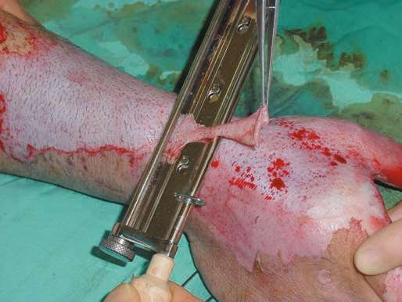
Tangential excision
Can be done within 48 hours with skin grafting in patients with less than 25% burn
Usually done in deep dermal burns
Dead dermis is removed layer by layer Until fresh bleeding occurs
Later, skin grafting done
45

Slide 137
Escharotomy
Circumferential full-thickness burns to the limbs require emergency Surgery
The tourniquet effect of this injury is easily treated by incising the whole length of full-thickness burns. (done avoiding major Nerves)
Full thickness burns and deep partial-thickness burns that will require operative treatment will need to be dressed with an antibacterial dressing to delay the onset of colonisation of the wound by microorganisms
46

Slide 138
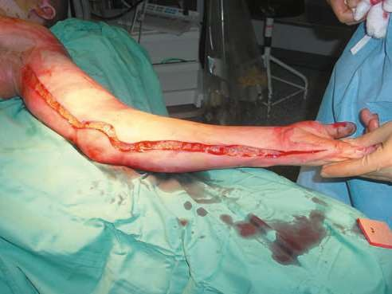
A full-thickness burn to the upper limb with a mid-axial escharotomy.
The soot and debris have been washed off.

Slide 139
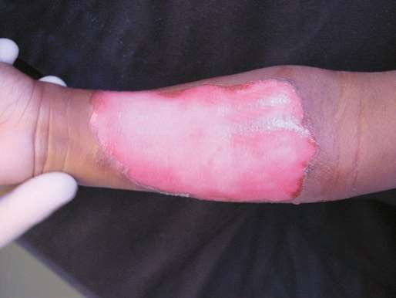
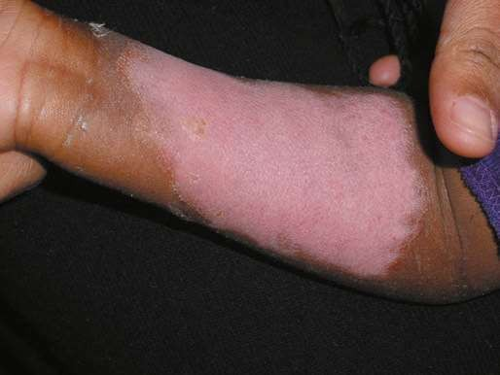
Superficial partial thickness burns
After 24 hours after burn
After 2 weeks

Slide 140
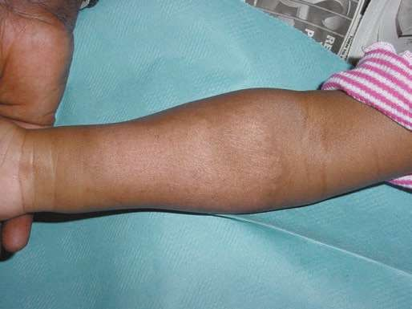
Superficial partial thickness burn after 3 months
Pigment returning

Slide 141
Effects of burns
Shock due to hypovolaemia
Renal failure (toxins from burn)
Pulmonary oedema, resp infections, Acute resp. distress syndrome, resp failure, Infection by staph aureus, pseudomonas, etc leads to Septicemia
Fungal and viral infections may also occur.
Fluid and electrolyte imbalance.
Immunosuppression predisposes to severe opportunistic infection.
Eschar formation and its problems e.g. ischaemia when it is circumferential. (eschar is a dry, dark scab made of dead skin)
Electrical injuries often cause fractures, major internal organ injury, convulsions.

Slide 142
Effects of burn (cont…..)
Inhalation burn causes pulmonary oedema, respiratory arrest
Severe malnutrition with catabolic status,
Toxic shock syndrome: It is a life-threatening exotoxin mediated disease caused by Staphylococcus aureus. It is common in children, presents with rashes, myalgia, diarrhoea, vomiting, and multiorgan failure with high mortality
Development of contracture is a late problem. It may lead to disability of different joints, defective hand functions, growth retardation causing shortening etc

Slide 143
COMPLICATIONS OF BURNS CONTRACTURES
Ectropion of eyelid ( eyelid turns outward) causing keratitis and corneal ulcer.
Disfigurement in face.
Narrowing of mouth (microstomia).
Contracture in the neck causing restricted neck movements.
Disability and nonfunctioning of joints due to contracture
Hypertrophic scar and keloid formation.

Slide 144
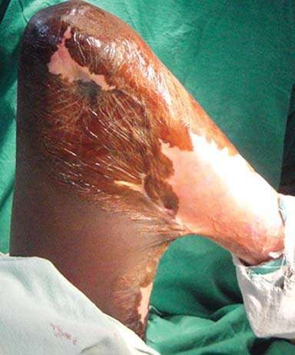
Contracture
Severe contracture at knee joint causing deformity

Slide 145
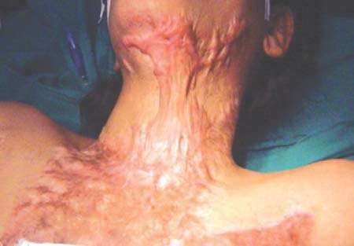
Complication of contracture
Hypertrophic scar

Slide 146
Treatment of burn contracture
Release of contracture surgically and use of skin graft.
Proper physiotherapy and rehabilitation is essential.
Management of itching in the scar using antihistamines and moisturizing creams.

Slide 147
Prevention of development of contracture
Joint exercise in full range during recovery period of burns

Slide 148
ASSESSEMENT OF TOTAL BODY SURFACE AREA (TBSA) FOR BURNS
METHODS
By depth
Rule of 9 -Estimated percentage of total body surface area (TBSA) in the adult is arrived at by sectioning the body surface into areas with a numerical value related to nine. . Head-9%, trunk anterior and posterior 36%,upper limbs 18%, lower limbs 36%, gentalia1%. Any burn with above 25% provokes a systemic response. The patient’s palm for small burns- 1%
Lund and Browder chart – allocates percentage as per the body anatomical parts.

Slide 149
WOUND HEALING

Slide 150
WOUND HEALING
Wound healing is a mechanism by which the body attempts to restore the integrity of the injured part.
Factors influencing healing of a wound
Site of the wound
Structures involved
Mechanism of wounding
Type of incision
Contamination (foreign bodies/bacteria)
Loss of tissue on the wound

Slide 151
Cont’-----
Local factors
Vascular insufficiency (arterial or venous)
Previous radiation
Systemic factors
Malnutrition or vitamin and mineral deficiencies
Disease (e.g. diabetes mellitus)
Medications (e.g. steroids)
Immune deficiencies [e.g. chemotherapy, acquired immunodeficiency syndrome (AIDS)]
Smoking

Slide 152
Types of wounds
Surgical- created intentionally to attend to a pathology
Traumatic wounds- accidental wounds e.g burns, crush, cuts etc
Chronic – develop due to chronic conditions e.g pressure ulcers, skin conditions, abscesses etc (more classifications exist)
Healing may occur in one of the following:
1. Healing by Primary intention
Healing through primary intention occurs when wounds are created aseptically, with a
minimum of tissue destruction tissue reaction.

Slide 153
Conditions in healing by primary intention
Edges of an incised wound in a healthy individual are promptly
and accurately approximated.
Contamination is held to a minimum by rigid adherence to
aseptic technique.
Trauma is minimal.
No tissue loss occurs.
On completion of closure, no dead space remains to become a potential site of infection.
Drainage is minimal.

Slide 154
Cont----
2. Healing by secondary intention
These type of wounds are characterized by tissue loss with an inability to approximate wound edges.
The wound heals from the inside toward the outer surface.
In infected wounds this process allows cleaning and dressing.
Healing is by granulation and eventually there is scarring .
These type of wounds include chronic , septic and traumatic wounds

Slide 155
3. Healing by tertiary intention
Occurs when approximation of wound edges is intentionally delayed by 3 or more days after injury or surgery.
This could be due to heavy contamination of wound or condition of patient.
Debridement may be done then wound closed later

Slide 156
Phases of wound healing
Hemostasis – Contraction of carpillaries to stop the bleeding
Inflammatory(Reactive ) – A vascular and cellular response to dispose off bacteria, foreign material and dead tissue.
Leukocytes (Neutrophils, Monocytes and macrophages) increase in number to fight bacteria in the wound area and by phagocytosis, help to remove damaged tissues, and foreign bodies.
There is also an increase in platelets.

Slide 157
Cont,.
The vascular response is about dilatation of blood vessels to allow permability of exudate for supply of more oxygen, plasma proteins and bradykinins for healing process. This causes redness, local warmth, and swelling.
The damaged tissue is glued together by strands of fibrin and a thin layer of clotted blood, forming a scab. Plasma seeps to the surface to form a dry, protective crust. This seal helps to prevent fluid loss and bacterial invasion.

Slide 158
iii. Proliferative(Regenerative )
Epithelial cells migrate and proliferate to the wound area, covering the surface of the wound .
Collagen synthesis, deposit and contraction of the wound occur in this phase. Underneath the epithelium layer, granulation continues. Epithelialization is limited to small wounds while larger ones may require grafting.
Remolding(Maturation)
The phase starts 2-4 wks after injury and may continue for years.
There is deposition of collagen fibres and breakdown of earlier deposits, as well as realignment of the fibres till the scar is strongly formed.

Slide 159
SHOCK

Slide 160
SHOCK
Definition: Shock is a systemic state of low tissue perfusion, which is inadequate for normal cellular respiration.
**With insufficient delivery of oxygen and glucose, cells switch from aerobic to anaerobic metabolism. If perfusion is not restored in a timely fashion, cell death occurs.

Slide 161
Classification of shock
Hypovolaemic- caused by a reduced circulating volume.
Cardiogenic- failure of the heart to pump out enough blood to the tissues.
Obstructive- there is a reduction in preload because of
mechanical obstruction of cardiac filling e.g pulmonary /air embolism
Distributive- include septic, neurogenic, anaphylactic and endocrinogenic causes

Slide 162
Signs and symptoms of shock
General S&S
Confusion and weakness
Low blood pressure
Decreased urine output
Tachycardia (a fast heart rate)
Rapid, shallow breathing
Cold, clammy skin
Rapid, weak pulse
Dizziness or fainting
Weakness

Slide 163
Stages of shock
i) Compensatory stage
The body tries to compensate for the low blood volume by:
Contactibility of heart
Peripheral vasoconstriction
Reduced urine output
Signs and symptoms of this stage may include:
Normal BP, tarchycardia, hypervetilation,raised pH level,confusion or anxiety, cold clammy skin. etc

Slide 164
ii) Progressive stage
Characterised by:
Failed cardiac ability of meet the demand and myocardial ischemia and hypoperfusion of all organs
Systemic vasodilation as a result of release of chemical mediators into blood stream

Slide 165
Signs and symptoms in this stage:
Slow heart rate of below 60 beat /min
Low BP below 90mmhg
Rapid and shallow respirations
Crackles due to fluid in the lungs
Unconcious state
Stress ulcers may lead to intestinal bleeding
Signs of acute renal failure
Raised bilirubin levels
Low ph
Jaudice
Tissue oedema

Slide 166
iii) Irreversible stage
Most of the organs are damaged beyond repair and death is likely.
Signs and symptoms remain as those of the progresive phase.

Slide 167
MANAGEMENT OF SHOCK
Depending on the type or the cause of the shock, treatments differ.
In general, fluid resuscitation (giving a large amount of fluid to raise blood pressure quickly) with an IV in the ambulance or emergency room is the first-line treatment for all types of shock.
The doctors or nurses will also administer medications such as epinephrine, norepinephrine, or dopamine to the fluids to try to raise a patient's blood pressure to ensure blood flow to the vital organs.
Tests (for example, blood tests, EKGs) will determine the underlying cause of the shock and uncover the severity of the patient's illness.
Nutritional needs

Slide 168
Rx
Septic shock is treated with prompt administration of antibiotics depending on the source and type of underlying infection.
These patients are often dehydrated and require large amounts of fluids to increase and maintain blood pressure.
Anaphylactic shock is treated with diphenhydramine (Benadryl), epinephrine, steroid medications methylprednisolone

Slide 169
Rx
Cardiogenic shock is treated by identifying and treating the underlying cause.
A patient with a heart attack may require cardiac catheterization to unblock an artery.
A patient with congestive heart failure may need medications to support and increase the force of the heart's beat. In severe or prolonged cases, a heart transplant may be the only treatment.
Hypovolemic shock is treated with fluids (saline) in minor cases, but may require multiple blood transfusions in severe cases. The underlying cause of the bleeding must also be identified and corrected.

Slide 170
Neurogenic shock is the most difficult to treat.
Damage to the spinal cord is often irreversible and causes problems with the natural regulatory functions of the body.
Besides fluid monitoring:
Immobilization (keeping the spine from moving),
Anti-inflammatory drugs such as steroids
Sometimes surgery are the main parts of treatment.

Slide 171
Nursing management
In CCU setting
Monitoring – hemodynamic monitoring( ECG, ABGs, renal function tests Etc)
Cordination of Collaborative management
Administration of drugs and fluids
Family involvement
Documentation of care

Slide 172
FLUID AND ELECTROLYTE IMBALANCE (60% of body wt is made up of fluids )

Slide 173
FLUID AND ELECTROLYTE IMBALANCE
Fluid compartments
Extra cellular
Intravascular
interstitial
Intracellular (within the cells)
Transcellular –(cerebrospinal, pericardial, synovial, intraocular, and Pleural spaces)
Third space- abnormal amount of fluid trapped in peritonial, plueral or other tissues.

Slide 174
To maintain homeostasis the body regulates the output to match the input by the renal system, adrenal glands, pituitary glands ( renin, angiotensin II, aldosterone and ADH)

Slide 175
A. FLUID IMBALANCE
CAUSES
Fluid volume deficit: caused by:
Trauma- burns, excessive bleeding
Diseases such as diarrheal, systemic dieases leading to third spacing. Eg. Ascites, pleural effusion, edema, internal heamorrhage etc
Insufficient intake
Renal disease
Congestive cardiac failure
Diabetis mellitus,
Diuretic overuse

Slide 176
Effects of imbalances
Low fluid volume - poor cardiac output- poor tissue perfusion - shock
Poor cell metabolism
Reduced skin targor, muscle clamps, dizziness, hypotension, peripheral constriction, reduced renal output, sunken eyes, nausea, lethargy, confusion , acute brain failure and ureamia

Slide 177
Management
Fluid replacement – oral or intravenous
Transfusion – whole or plasma depending with what was lost
Over a litre – give colloids e.g dextran hemacel etc
Treat underlying conditions
Fluid overload is rare in a functioning renal system but could be related to other sytemic illnesses e.g CCF.

Slide 178
Fluid volume excess: caused by
Administration of Excessive amounts of hypo- osmolar fluids- e.g 0.45% Saline/ 5% Dextrose in water.
Excessive intake of fluid
Inability to excrete excess water(Renal)
Poor sodium intake
Use of diuretics
Loss of sodium and water & replaced only by water
Fluid overload i.e., water and sodium retention.
Stressful conditions cause increase in release of ADH and aldosterone which increases water reabsorption from renal tubules.

Slide 179
Clinical manifestations
Cerebral Edema- Behavioral changes, headache Inc. ICP, & pupillary changes
Vital Signs alterations-
Bradycardia
Increased systolic B.P.
Increased respiration
Pulse?

Slide 180
Clinical manifestations
Others-
Nausea
Projectile vomiting
Irritability
Disorientation
Confusion
Drowsiness
Decreased co-ordination
Increase in weight
Convulsions.

Slide 181
Clinical manifestations
Peripheral or generalized oedema
Circulatory overload causes:
Bounding pulse
Distended neck and peripheral vein
Cough , dyspnoea , orthopenea
Crackles in lungs
Increased urine output
Ascites
Altered mental status and anxiety

Slide 182
Lab findings
Serum sodium level
Decrease hematocrit value.

Slide 183
Management
1. Medication: Diuretics- commonly used to treat fluid volume excess.
They inhibit sodium and water reabsorption, increasing urine output.
LOOP DIURETICS: Furosemide [Lasix].
THIAZIDE LIKE DIURETICS: Chlorothiazide [Diuril].
POTASSIUM SPARING DIURETICS: Spironolactone [Aldactone]

Slide 184
2. Fluid Management:
Fluid intake may be restricted to client having fluid volume excess.
3. Dietary management:
Because sodium retention is a primary cause of fluid volume excess, so sodium restriction diet is often prescribed.
Check- Reflexes and pupillary response.
Monitor I/V therapy hourly.
Check weight daily.
Safety measures- if client shows behavioral changes.

Slide 185

NURSING MANAGEMENT
Assessment
Assess early signs of cerebral edema and Increased intracranial pressure.
Assess absence of thirst, Decreased hematocrit, & Serum Sodium levels.

Slide 186
NURSING DIAGNOSIS
1. Excess fluid volume:
Assess vital signs, heart sounds and BP.
Assess for the presence of edema.
Obtain weight daily at same time of day.
Provide oral hygiene 2hourly.
Teach client about sodium restricted diet.
Report significant changes in serum electrolytes.
Administer oral fluids cautiously
Administer diuretics as prescribed.

Slide 187
2. Risk for impaired skin integrity :
Assess skin in pressure area and over bony prominences.
Change position of client 2 hourly.
Provide alternating pressure mattress, foot cradle, heel protectors, to reduce pressure on tissues.
3. Risk for impaired gas exchange:
Auscultate lungs for presence of wheezes and crackles.
Place in fowler’s position if having dyspnea or orthopenea.
Monitor oxygen saturation level and ABG’s.
Administer oxygen as indicated.

Slide 188
B. ELECTROLYTE IMBALANCE
Electrolyte functions:
Transmission of neural impulses
Muscle contraction and majorly the cardiac muscle( myocardium)
Body fluid movement & retention- intra /extracellular compartments
Acid-base balance
**In cases of imbalance of electrolytes then the transmission of impulses and muscle contraction is affected

Slide 189
Most important electrolytes
Na- extra cellular-135 - 142 mmol/l
K- intracellular 3.5 - 5.5mmol/l
Ca- extra cellular-2.15 – 2.5 mmol/L
Mg- intracellular-0.65 – 1.25mmol/l
Cl – extra cellular-97–107 mmol/L
Phosphorus- intracellular-0.87–1.45mmol/l
Hydrogen carbonate- extracellular- 110-124mmol/l
Imbalances may occur when there is loss or retention as a result of illnesses.

Slide 190
Hyponatremia
- Sodium level lower than 135mmol/l
Causes:
Diarrhea,
Vomiting,
Excessive sweating,
Impaired kidneys,
Addison’s disease (insufficient production of aldosterone),
Overuse of diuretics,
Excess water retention

Slide 191
Effects
Blood volume is low,
Hypotention abdominal muscle cramps,
Nausea,
Fatigue,
In severe cases: confusion, muscle twitching and convulsions.
Management
Normal diet with salt if not severe, Iv N/s (restriction of fluids if causes
related to fluid retention), salt tablets,
Close monitoring of serum levels
Management of systemic conditions

Slide 192
Hypernatremia
Caused by:
Reduced water intake,
Cushings syndrome,
Fasting,
Vomiting,
Burns,
Hypertonic solutions such as 4.5% N/S etc

Slide 193
Effects
Thirst,
Nausea and vomiting,
Confusion
Lethargy and weakness,
Hallucination in severe cases
Peripheral and pulmonary edema,
Postural hypotension

Slide 194
Management
Treat the cause e.g. Give water or fluids with low sodium (hypotonic solution) with care not to bring down the levels so fast which may lead to brain edema.
Promptly manage systemic causes.
Monitor the serum sodium levels

Slide 195
Cont’---
Hyperkalemia
Potassium levels above 5.5 mmol/l
Causes:
Hemolysis due to trauma,
Renal failure,
Acidosis and physiologically after exercises,
Iatrogenic causes (treatment related, potassium chloride, heparin, ACE inhibitors, nsaids, and potassium-sparing diuretics)

Slide 196
Effects
Muscle weakness, at times paralysis,
ECG changes such as narrow T waves and a shortened QT interval.
Nausea,
Diarrhea.

Slide 197
Management
Monitor Serum potassium levels and ECG changes
Restriction of dietary potassium for patients using potasium retention diuretics
Calcium gluconate intravenously (Ca salts antagonize the effects of potassium in cells)
Continous monitoring of patient on ECG

Slide 198
Hypokalemia-
Serum potasium below 3.5mmol/l
Causes
Diarrhea
Vomiting,
Ileostomies,
Metabolic alkalosis,
Prolonged intestinal suctioning,
Hyperaldostronism,
Potassium-losing diuretics,
Elderly,

Slide 199
Signs and symptoms
Fatigue ,
Anorexia,
Nausea,
Vomiting,
Muscle weakness,
Leg cramps,
Paresthesias (numbness and tingling),
ECG changes - flat T wave

Slide 200
Management
If not severe, dietary measures could elevate the levels
If severe ( below 2mmol/l) then intravenous infusions with potasium is administered with care and should be at 10-20mmol/hr and not more
ECG monitoring
Serum potasium monitoring
Read and make notes on hypo/hypercalcemia, hypo/hypermagnesia and hyper/hypo phosphatemia**

Slide 201
ACID-BASE IMBALANCE

Slide 202
Acid-Base Imbalance
The imbalance is measured as per the serum pH level which is basically a measure of acidity.
Normal serum pH is 7.35-7.45
Types of imbalances
Acidosis- a state when the PH level in the blood is below 7.3 and the alkaline buffers eg. Sodium bicarbonate has been used up.
Alkalosis – the ph level of blood is above 7.5 and the acidic reserve is used up.
The buffer system, kidneys and lungs are unable to contain the situation of regulating the pH therefore the 2 states develop.

Slide 203
Clinically, the following scenarios are significant:
Metabolic acidosis
Metabolic alkalosis
Respiratory acidosis
Respiratory alkalosis

Slide 204
a) Metabolic acidosis
Can be acute or chronic.
A state where there is low pH and low bicarbonate in serum
Causes
Ketoacidosis,
Lactic acidosis,
Late phase of salicylate poisoning,
Uremia
Methanol toxicity

Slide 205
Signs and symptoms
Headache,
Confusion,
Drowsiness,
Increased respiratory rate and depth,
Nausea, and vomiting,
Peripheral vasodilation
Decreased cardiac output occur when the pH falls below 7.

Slide 206
Management
Blood gas analysis- ph level,
Sodium bicarbonate level,
Co2 and potasium levels.
ECG monitoring
Sodium bicarbonate is administered in low pH below 7 treat the underlying cause
Calcium gluconate is administered in chronic metabolic acidosis to prevent tetany

Slide 207
b) Metabolic alkalosis
Characterized by increased pH of above 7.5 and an increased sodium bicarbonate level
Causes
Gastric fluid loss through vomiting or suctioning,
Hyperaldosteronism
Cushing’s syndrome,
Hypokalemia,
Long term diuretic therapy,
Overuse of antacids,
Chronic ingestion of milk and calcium carbonate.

Slide 208
Signs and symptoms
Tingling of fingers,
Depressed respiratory rate,
Decreased motility,
Hypertonic muscles ,
Hypokalemia
Management
Blood gas analysis – level of ph is increased, the bicarbonate is high, the CO2 is high since the pt is hypoventilitating
Restoration of fluid volume
In order for kidneys to excrete bicarbonate, NaCl is given
Treat the underlying condition.

Slide 209
c) Respiratory acidosis
Could be either acute or chronic
Characterized by pH less than 7.35
Causes
Conditions that lead to retention of co2 e,g.
Acute pulmonary edema,
Obstruction by foreign object,
Atelectasis,
Pneumothorax,
Overdose of sedatives,
Severe pneumonia
Acute respiratory distress syndrome

Slide 210
Signs and symptoms
High pulse rate,
Increased respiratory rate,
Increased blood pressure,
Mental cloudiness,
Feeling of fullness in the head.
Cerebrovascular vasodilation and increased cerebral blood flow,
Increased intracranial pressure (icp)

Slide 211
Management
Blood gas analysis
Improve ventilation by positioning or removal of obstructing body, put pt on mechanical ventilator if very severe. Otherwise administer oxygen via mask
Give medications which could address the cause e.g antibiotics, bronchodilator etc.
Give fluids
Monitor on ECG

Slide 212
d) Respiratory alkalosis
A state when the arterial pH is greater than 7.45.
Causes
Extreme anxiety,
Hypoxemia,
The early phase of salicylate intoxication,
Gram-negative bacteremia,
Poor setting of mechanical ventilator machine

Slide 213
Signs and symptoms
Lightheadedness - decreased cerebral blood flow,
Inability to concentrate,
Numbness and tingling from decreased calcium ionization,
Tinnitus,
Loss of consciousness,
Tachycardia

Slide 214
Management
Investigations: Blood U&E- low potasium ,decreased phosphate, hypercalcemia
Relieve anxiety by reassurannce or sedation
Treat underlying cause.

Slide 215
END

